Slide 1
CSE 331
Automata and computability
Lecture 2
Summer 2026

Slide 2
Today's learning goals Sipser Ch 1.1
Use and design a finite automaton via its
  - Formal definition - state diagram
Identify the strings and languages accepted by a given finite automaton
Design a finite automaton which accepts a given language
Define the regular operations on languages

Slide 3
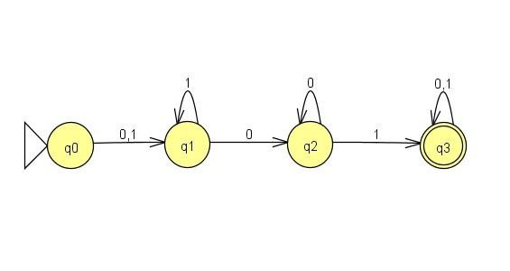
Deterministic Finite Automaton (DFA)
Input: finite string over a fixed alphabet
Output: "accept" or "reject"
Language of the machine is the set of strings it accepts
Start state
(triangle/arrow)
Accept state
(double circle)

Slide 4
Deterministic finite automaton
Input: finite string over a fixed alphabet
Output: "accept" or "reject"
Does this DFA accept the empty string ?
Yes
No
I don't know

Slide 5
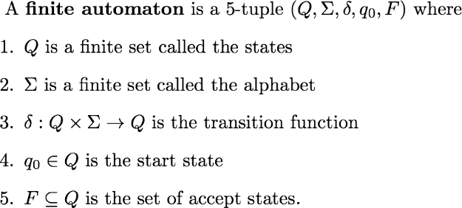
Deterministic finite automaton Sipser p. 35 Def 1.5
No circles and arrows, same information!

Slide 6
Deterministic finite automaton Sipser p. 35 Def 1.5
Can there be more than one start state in a finite automaton?
Yes, because of line 4.
No, because of line 4.
I don't know

Slide 7
Deterministic finite automaton Sipser p. 35 Def 1.5
How many outgoing arrows from each state?
May be different number at each state.
Must be 2.
Must be |Q|.
Must be |Σ|
I don't know.

Slide 8
An example
Define M = where the function δ is specified by its table of values:
Draw the state diagram for the DFA with this formal definition.
Input in Q x Σ | Output in Q
(q1,a) | q3
(q2,a) | q2
(q3,a) | q3
(q4,a) | q2
Input in Q x Σ | Output in Q
(q1,b) | q2
(q2,b) | q2
(q3,b) | q4
(q4,b) | q4

Slide 9
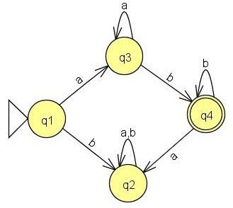
An example
What's an example of a
length 1 string accepted by this DFA?
length 1 string rejected by this DFA?
length 2 string accepted by this DFA?
length 2 string rejected by this DFA?

Slide 10
An example
What's the best description of
the language recognized by this DFA?
Starts with b and ends with a or b
Starts with a and ends with a or b
a's followed by b's
More than one of the above
I don't know.
and using set notation?

Slide 11
An example
This DFA recognizes
the language of all strings
of the form a's followed by b's
i.e. { a^{n}b^{k} | n,k ≥ 1}

Slide 12
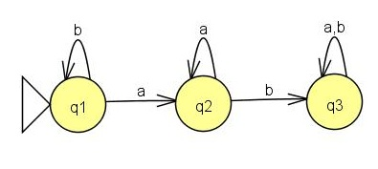
Specifying an automaton
( {q1,q2,q3}, {a,b}, δ, q1, ? )
What state(s) should be in F so that the language of this machine is
{ w | ab is a substring of w}?
{q2}
{q3}
{q1,q2}
{q1,q3}
I don't know.

Slide 13
Specifying an automaton
( {q1,q2,q3}, {a,b}, δ, q1, ? )
What state(s) should be in F so that the language of this machine is
{ w | b's never occur after a's in w}?
{q2}
{q3}
{q1,q2}
{q1,q3}
I don't know.

Slide 14

Building DFA
Typical questions
Define a DFA which recognizes the given language L.
or
Prove that the (given) language L is regular.

Slide 15
Building DFA
Example
Define a DFA which recognizes
L₁ = {w | w ends with a 1}

Slide 16
Building DFA
Example
Define a DFA which recognizes
L₂ = {w | w has substring 11}

Slide 17
Building DFA
Example
Define a DFA which recognizes
L₃ = {w | w has even length}

Slide 18
Building DFA
Example
Define a DFA which recognizes
L₄ = {w | length of w is two}

Slide 19
Building DFA
Example
Define a DFA which recognizes
L₅ = {w | w starts with 1 and ends with 0}

Slide 20
Building DFA
Example
Define a DFA which recognizes
L₆ = {w | w has at least 2 a's}

Slide 21
Building DFA
Example
Define a DFA which recognizes
L₇ = {w | w has at most 2 a’s}

Slide 22
Building DFA
Example
Define a DFA which recognizes
L₈ = {w | w starts and ends with a or w starts and ends with b}

Slide 24
Building DFA
Remember
States are our only (computer) memory.
Design and pick states with specific roles / tasks in mind.
"Have not seen any of desired pattern yet"
"Trap state"

Slide 25
Justification?
To prove that the DFA we build, M, actually recognizes the language L
WTS L(M) = L
Is every string accepted by M in L?
Is every string from L accepted by M?
  or contrapositive version: Is every string rejected by M not in L.

Slide 26
A useful (optional) bit of terminology
When is a string accepted by a DFA?
Computation of M on w: where do we land when start at q₀ and read each symbol of w one-at-a time?
δ*( q, w ) =
Recursively defined function

Slide 27
Regular languages Sipser p. 35 Def 1.5
For DFA M over the alphabet Σ
  For each string w over Σ, M either accepts w or rejects w
  The language recognized by M is the set of strings M accepts
  The language of M is the set of strings M accepts
  L(M) = { w | w is a string over Σ and M accepts w}
Definition: A language is regular iff there is some finite automaton that recognizes exactly it.

Slide 28
Regular languages: bounds?
Is every finite language regular?
No: some finite languages are regular, and some are not.
No: there are no finite regular languages.
Yes: every finite language is regular.
I don't know.

Slide 29
For next time
Read the assigned reading
Start solving the DFA portion of the assignment that will be released soon.
Review Sipser Ch 0 as needed.

